Slide 1

Team Normal Peeps
Analyzing Unstructured Data
Group 1
Client Name: Craigslist
06 – Dec – 2023

Slide 2
Problem Understanding
Solution Approach
Framework Overview
Framework Components
Text Classification
Image Classification
Final Heuristic (Image + Text Classification) model
Conclusion
Recommendations
Future Scope
AGENDA

Slide 3
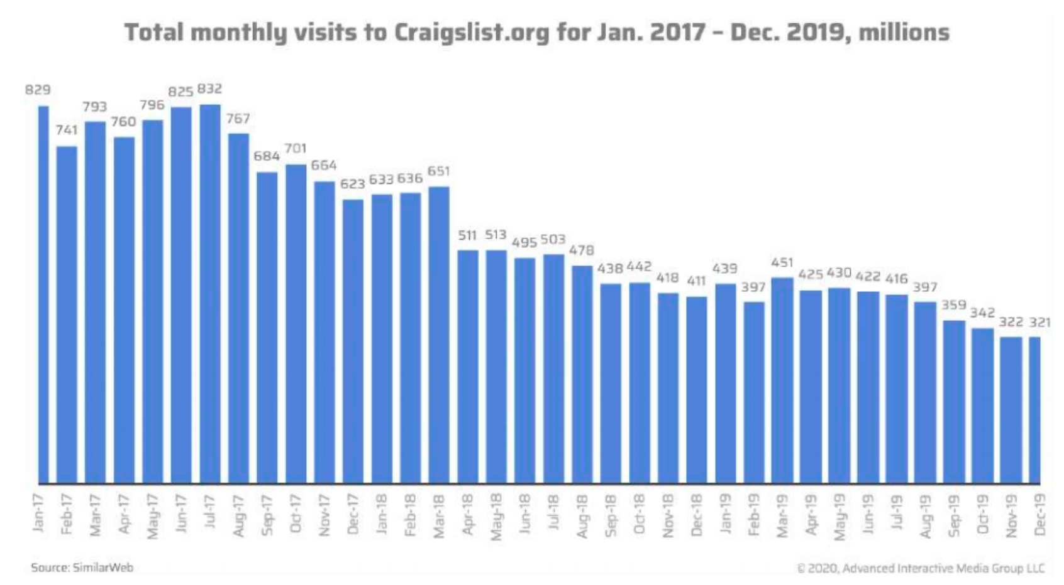
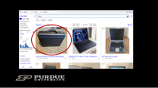
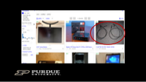
PROBLEM UNDERSTANDING
Optimizing Craigslist's categorization to accurately differentiate computer products and accessories for a more efficient and relevant user search experience
More than 30% of Computers are misclassified
More than 15% Computer Parts are misclassified

Slide 4






Current State & Desired Future State
Optimizing Craigslist's categorization to accurately differentiate computer products and accessories for a more efficient and relevant user search experience
The computers and computer parts are frequently misclassified, leading to inefficiencies and frustration for users
The search process needs to be streamlined, by effective categorization
Outcome: To improve the user experience on Craigslist by developing a more accurate and user-friendly system for categorizing these items
Tasks at hand: By employing text and image-based classification techniques, we aim to extract relevant information from the product information to recommend the most suitable category for the item
What are we solving?
Increased Search Time
Purchase of Incorrect Items
Increased Customer Support Queries
Erosion of Confidence
Frustration & User Experience Deterioration
Lost Sales for Retailers
Inefficiency in Comparison Shopping

Slide 5
FRAMEWORK OVERVIEW
We propose to develop a heuristic model combining Text and Image Classification Techniques to effectively categorize computers and computer parts on Craigslist

Slide 6


Proposed Model Framework
F
Framework Skeleton
Data Preprocessing
Training Data
Testing Data
Amazon (80%)
Amazon (20%)
IMAGE
Resize to 64*64
Convert to RGB color space
Normalization
VGG16 model
Data Scraped
(1500 Products – 100%)
Title
Image URL
Validation Data
Craigslist – Chicago
(200 products)
TEXT
Removal of non alpha numeric characters
Tokenization
Stopwords removal
Stemming
Lemmatization
CNN
Random Forest
Gradient Boosting
LSTM
Random Forest
Gradient Boosting
Data Scraped
Title
Description
Image URL
Image Classification
Text Classification

Slide 7
FRAMEWORK COMPONENTS

Slide 8
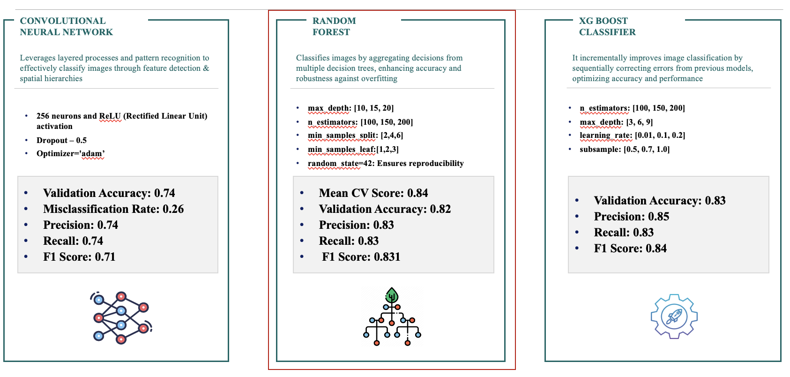
Image Classification
The 3-step process would be the base of the framework – training and testing on Amazon data and validating on Craigslist data
Image Preprocessing
Reshaping to 64x64 Pixels: Reshaping images to a fixed size (like 64x64) ensures uniformity in input dimensions, which is crucial for most machine learning models, including convolutional neural networks (CNNs).
Normalizing Pixel Values from 0 to 1: Normalization scales the pixel values to a range of 0 to 1. This process aids in the convergence of the model during training by ensuring that pixel values do not disproportionately influence the model’s learning.
Converting to RGB Color: Converting images to RGB ensures that all images are in the same color space. RGB (Red, Green, Blue) is a widely used color space in image processing.

Slide 9


Text Classification
The 3-step process would be cleaning
Text Pre-Processing
Training & Validation
Classification Models
Cleaning and processing the Text columns to remove unnecessary words
We tried different classification models
Predicting product class using different models
Amazon Dataset
Craigslist Data : Out of Sample Validation
Random Forests
n_estimators = 100
Random_Seed = 42
Min_samples_leaf = 1
Min_samples_Split = 2 Test Accuracy: 88%
Data Cleaning & Merging
Removing Non alpha numeric characters and emojis
Tokenization
Removal of stopwords
Stemming
Lemmatization
Model Building
Combined Text and Description Columns
Ran multiple classifier models
TF-IDF Vectorization
LSTM
Activation = soft_max
Input_dim = 5000
Neurons: 100 Test Accuracy: 90%
Text Classification Models : Random Forests

Slide 10




Final (Image + Text Classification)
The 3-step process would be the base of the framework - ingesting data, analyzing reports and recommend suitable actions
IMAGE CLASSIFICATION ENGINE
TEXT CLASSIFICATION ENGINE
MERGED CLASSIFICATION SYSTEM
Creating a Visual Understanding Model
Gathering and preprocessing image data from various sources
Image Data Augmentation
Image feature Extraction
Data Cleaning & Labeling
Annotating images with accurate labels
Noise Reduction techniques
Training/validation/test set splitting
Model Training & Validation
Convolution Neural Networks (CNNs), Random Forest, XG Boost
Performance metrics (Accuracy, Precision, Recall)
Hyperparameter Tuning
Building the Textual Analysis Framework
Text data acquisition and preprocessing ( tokenization, stemming, etc.)
Vectorization methods(TF-IDF,word embeddings)
Text Data Normalization
Handling missing or irrelevant data
Language model fine-tuning
Classification Model Development
Random Forest, LSTM's
Evaluation using confusion matrix, F1 score
Model optimization and regularization
Integrating Visual and Textual Data
Multi-model data fusion techniques
Feature engineering of combined data
Unified Data Processing
Synchronizing image and text data streams
Data alignment and multi-view learning
Joint Model Training
Getting a probabilistic output for the prediction model and setting up a threshold for the merged model
Misclassification Rate = 19.7%
Image Classification
Text Classification
Merged Model

Slide 11





Value Generated
Refining Categorization
By deploying sophisticated algorithms, our aim transcends mere correct placement of listings; we seek to ensure these listings are easily discoverable by potential buyers, thereby enhancing the overall marketplace efficiency.
Optimizing the User Journey
A user's journey, spanning from the moment of listing an item to finding the desired product, should be a streamlined and intuitive experience. Presently, this journey is often hindered by issues like the misplacement of computer accessories or the appearance of unrelated products in specific search queries. Our project directly addresses these challenges, seeking to provide a seamless and effective process for both buyers and sellers.
Technical Implementation: Advanced Categorization and Tagging
The dual-pronged approach is designed to intelligently suggest the most fitting categories for listings while generating relevant tags to improve searchability and visibility.
Data Analysis: The Foundation of Intelligent Categorization
This data forms the backbone of our categorization algorithms, ensuring the system is not only theoretically robust but also practically attuned to the real content of the listings.
Addressing Classified Ad Challenges
By improving the precision of our categorization, we aim to ensure each ad reaches its intended audience more effectively, reducing inefficiencies and enhancing the likelihood of successful transactions.

Slide 12






Recommendations | Future Scope
Data Standardization
Regular Database Updates
Ensuring that all computer and computer part listings follow a uniform format, making it easier to categorize and search.
Keeping the product database regularly updated with the latest products and ensuring old or obsolete products are correctly categorized or removed.
User-Friendly Categorization
Future Scope
Collaboration with Vendors
Developing a more intuitive and detailed categorization system. This can include categories based on product type, usage and compatibility.
Working closely with vendors to ensure that the information provided for each product is accurate and comprehensive, aiding in proper categorization.
Feedback Loop
Detailed Product Descriptions
Implementing a system for users to report misclassifications or suggest categorization improvements. This feedback can be used to continuously refine the categorization process.
Ensuring each product has a detailed and accurate description, which can aid in better categorization and search efficiency.

Slide 13
Thank you!
All the best for your final exams!

Slide 14
Q/A

Slide 15
Appendix

Slide 16















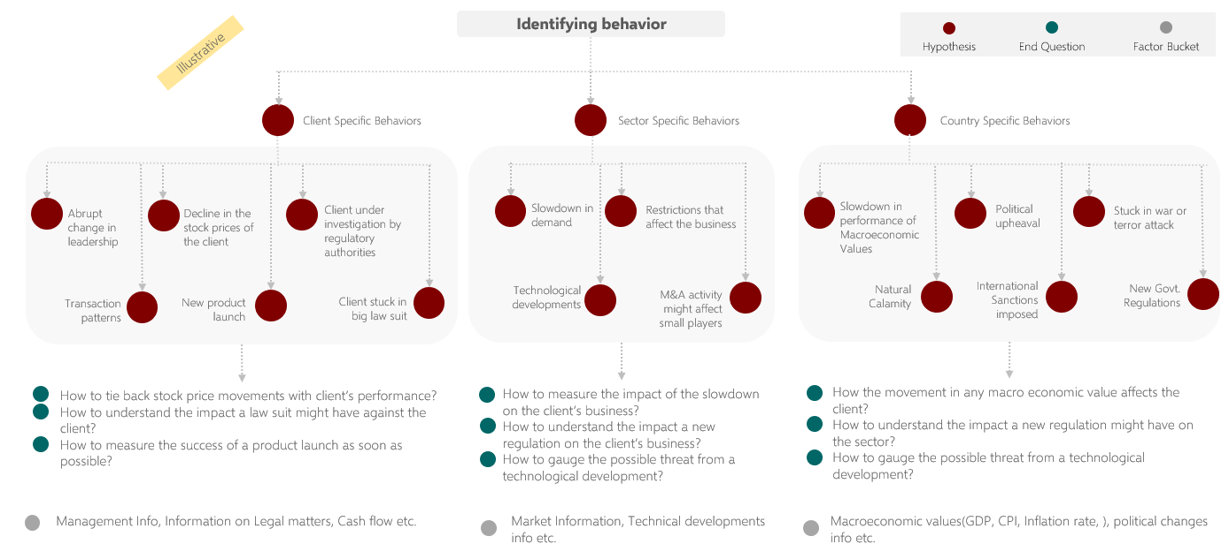
Framework Components
The framework consists of Text and Image Classification techniques
Data Sources identified by SABIC
BUSINESS INTELLIGENCE
MARKET INTELLIGENCE MODULE
Business Inputs
Determine key competitors across regions
Determine product offerings and market share
Range of products
Applications of the product range, grades etc. (based on rigidity and flexibility index)
Determine sales and pricing strategies
Analyze customs regulation changes
Review Boards and Forums information from SocialGist
Chatter on Twitter and SocialGist to identify latest sentiment around policy changes
Analyze product market trends and results based on region
Perform SWOT Analysis to learn competitor strengths, weaknesses, opportunities, and threats
Internal
Datasets
Historical
Reports
Latest Reports
Stakeholder Interactions
AoPSTM
Using Mu Sigma’s AoPSTM framework allows us to identify the key factors that affect market demand and price changes to design the hypotheses
We also recommend using
Behavioral Patterns
Socialgist provides a search API that can provide data from various types of sources like News articles, Blogs, Review boards, and forums and has access to over 2000+ sources
Some of their key data partners include tumblr, Disqus, Tencent, Weibo, Vertical Scope etc.
MA and CS Scoring
The MA and CS scoring will be done by performing hypotheses-based testing post business interviews and identifying behavioral patterns using the AoPSTM framework

Slide 17
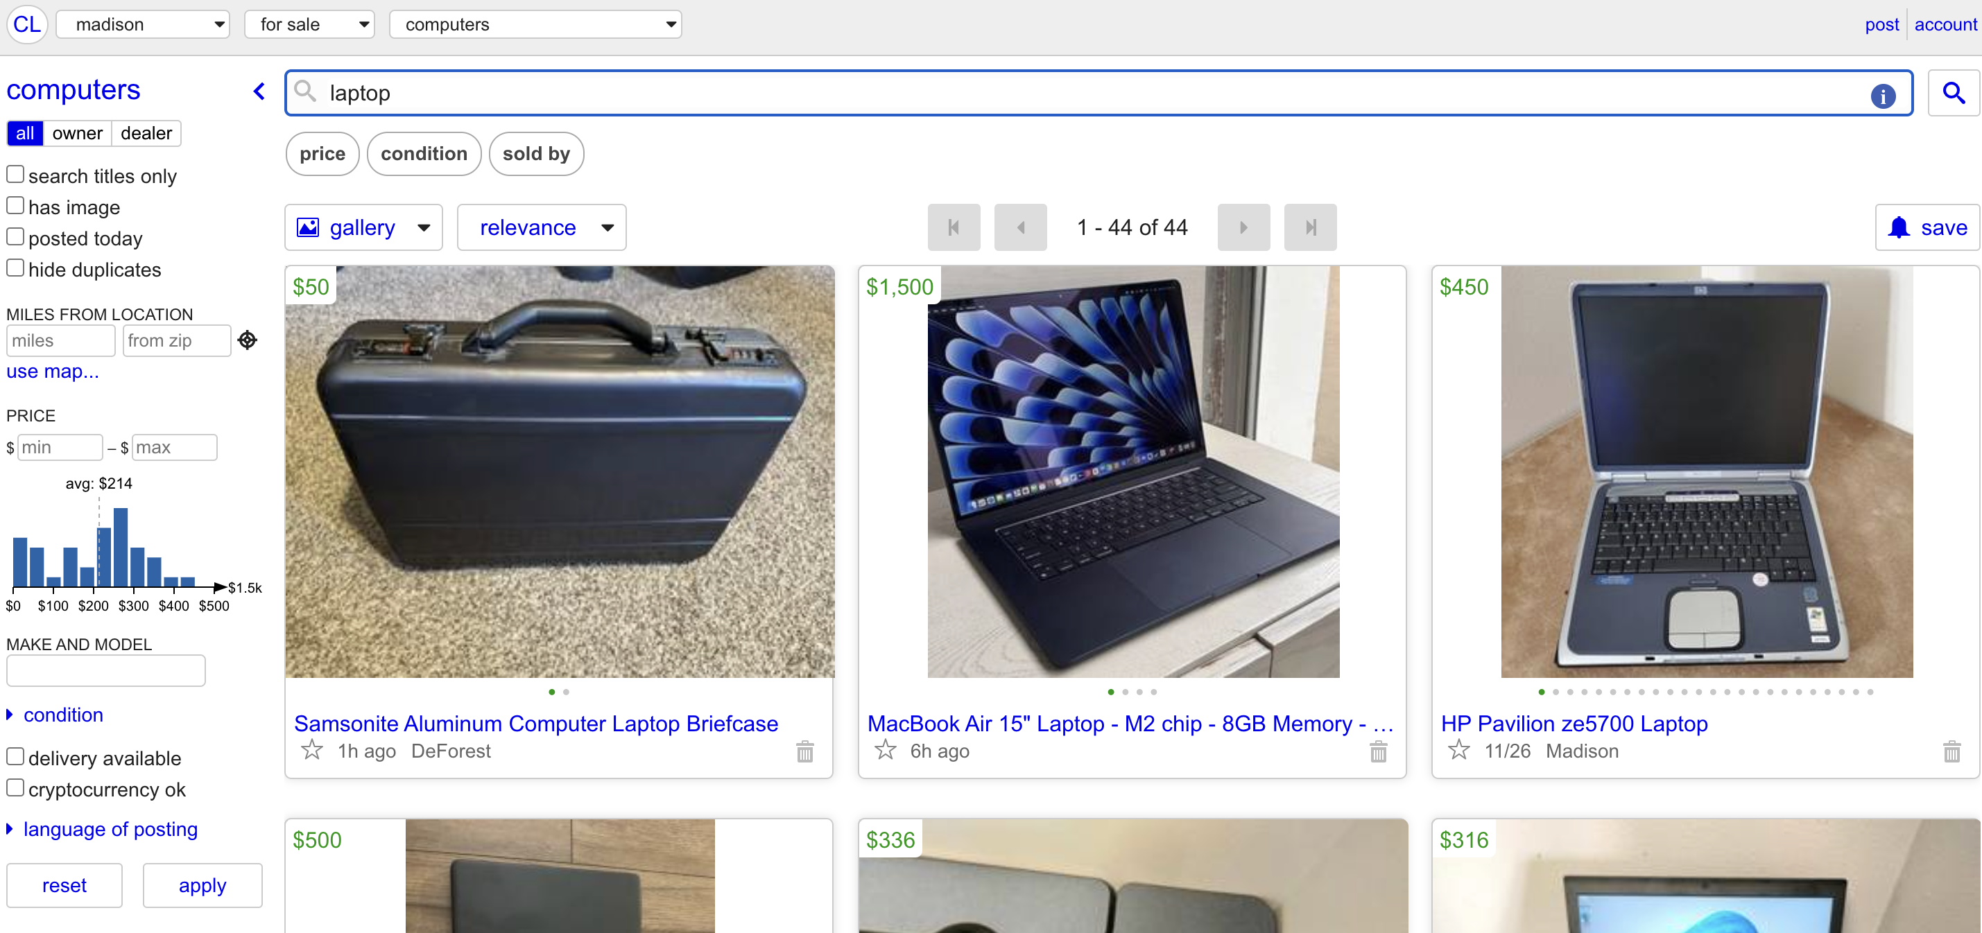

Slide 18
